Slide 1
HAUNTED HOUSE GAME

Slide 2
Introduction
“Haunted House Game” is a simple text-based adventure game which is designed to be played in console. In this game, player embarks on a spooky journey through haunted house ,filled with surprise and challenging decisions.
It relies on the power of words and choices the player makes in the course of game which immerse them in a spine tingling experience.

Slide 3
WORKING
Introduction and Starting Point:
The game begins by presenting the player with a description of the setting: standing in front of a creepy old haunted house. It asks the player if they want to enter the house by typing "yes" or "no“.
Game Flow:
If the player chooses to enter the house ,they are directed to the start Game method. In the start Game method, the player is in a dimly lit hallway with three doors. They are prompted to choose one of the doors by typing "1," "2," or "3."

Slide 4
Room Interactions:
Depending on the door chosen, the player enters one of the three rooms (room1, room2, or room3). Each room has its own unique description and interaction. Room 1: The player enters a library and encounters a ghostly figure. Room 2: The player enters a dark basement with a flickering light. Room 3: The player enters a bedroom filled with porcelain dolls.
Player Choices:
In each room, the player is given a choice to make such as approaching the ghost, investigating the light, or trying to grab a doll. The player responds with "yes" or "no“.

Slide 5
Outcome:
Depending on the player's choices, different outcomes occur. Successful choices may lead to acquiring items or escaping the haunted house. Unsuccessful choices may result in returning to the hallway or experiencing eerie events.
Repetition:
The game handles invalid input by prompting the player to re-enter their choice and repeating the interaction until a valid response is given.

Slide 6
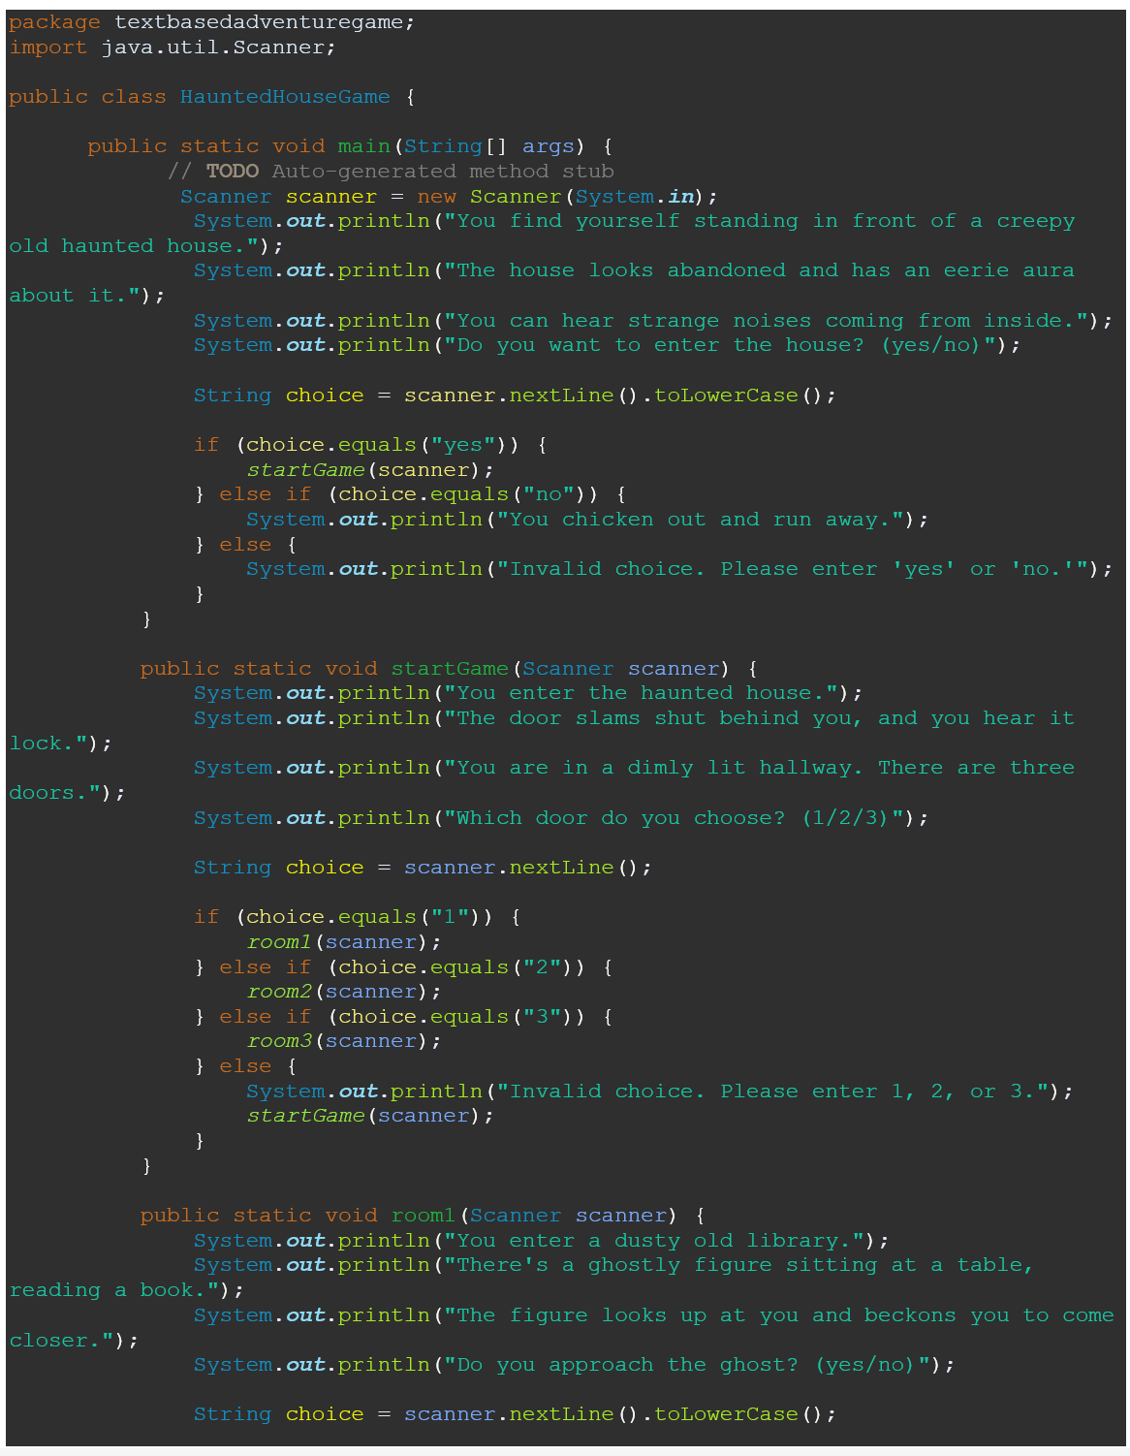
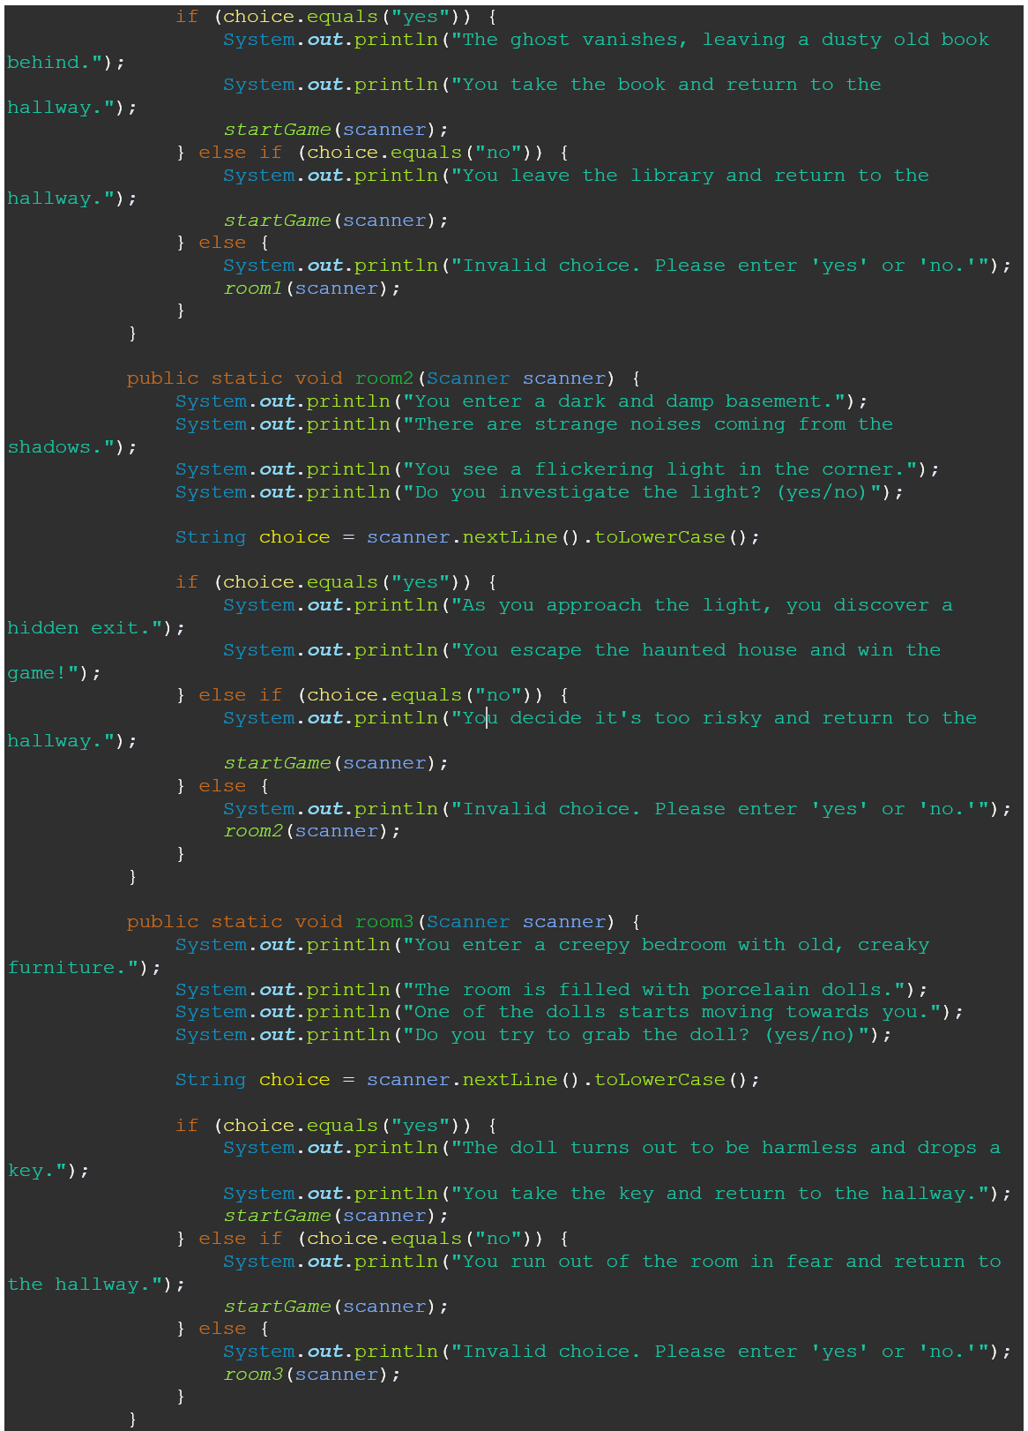
Screenshots:

Slide 7
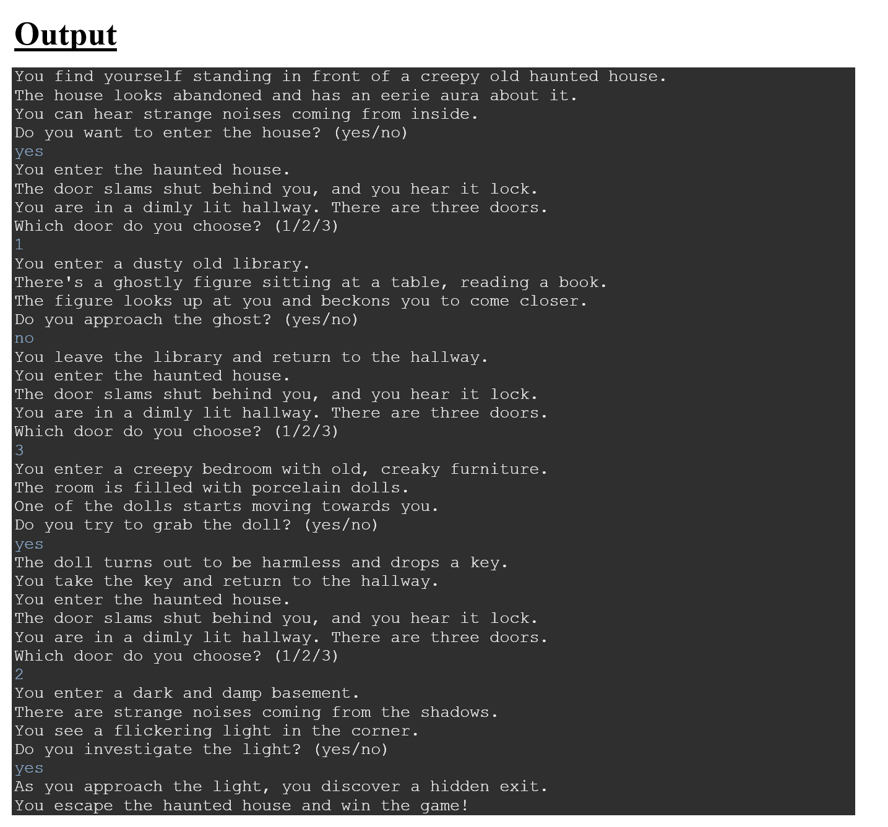

Slide 8
USES
Entertainment: The code is designed to create a simple text-based adventure game, providing entertainment to players.
Interactive Learning: It can serve as an educational tool to help beginners learn Java programming.
Storytelling: It tells a narrative through user interactions, making it an engaging way to convey a story.
Decision-Making: It allows players to make choices, affecting the game's outcome, and promotes decision-making skills.

Slide 9
ADVANTAGES
Ease of Understanding: The code is relatively simple and well-structured, making it accessible for Java beginners.
User Engagement: It engages users by presenting them with choices and a narrative.
Customizable: Developers can easily expand and modify the game, adding more rooms, puzzles, or narrative elements.
No Graphics Required: Being text-based, it doesn't require complex graphics or multimedia components, making development more straightforward.

Slide 10
DISADVANTAGES
Simplicity: The game is relatively simple, lacking complex puzzles or challenges that might engage experienced gamers.
Lack of Graphics: Some players may prefer games with graphical elements, which this code doesn't include.
Limited Replayability: Once players explore all rooms, the game may lose replay value, as the outcomes are fixed.

Slide 11
FUTURE SCOPE
Expand the Story: Developers can expand the narrative by adding more rooms, characters, or plot twists.
Add Puzzles: Integrate challenging puzzles or riddles to increase player engagement.
Graphics and Multimedia: Enhance the game with graphics, sound, or animations to create a more immersive experience.
Scoring System: Implement a scoring system to encourage players to explore different options and aim for higher scores.
User Profiles: Create user profiles to allow players to save their progress and revisit the game later.

Slide 12
CONCLUSION
In conclusion, the presented Java code represents a simple text-based adventure game called "HauntedHouseGame”. The code is a foundation for a text-based adventure game and can be extended with more rooms, interactions, and complex storylines. It serves as an example of how to create a basic interactive game in Java. Its potential can be fully realized by enhancing its complexity and interactivity, thereby catering to a broader audience and providing a more immersive gaming experience.

